Slide 1

Digital Nomad’s Paradise Found?
Cracking the Code
of Lisbon, Riga &
Barcelona
Chicken Group

Slide 2
Our approach to Data Preprocessing & Analysis
Research Question
Data Cleaning
Results
Data Collection
Data Analysis

Slide 3


THE QUESTION
HOW SUITABLE ARE THE CITIES LISBON, RIGA AND BARCELONA FOR DIGITAL NOMADS?

Slide 4
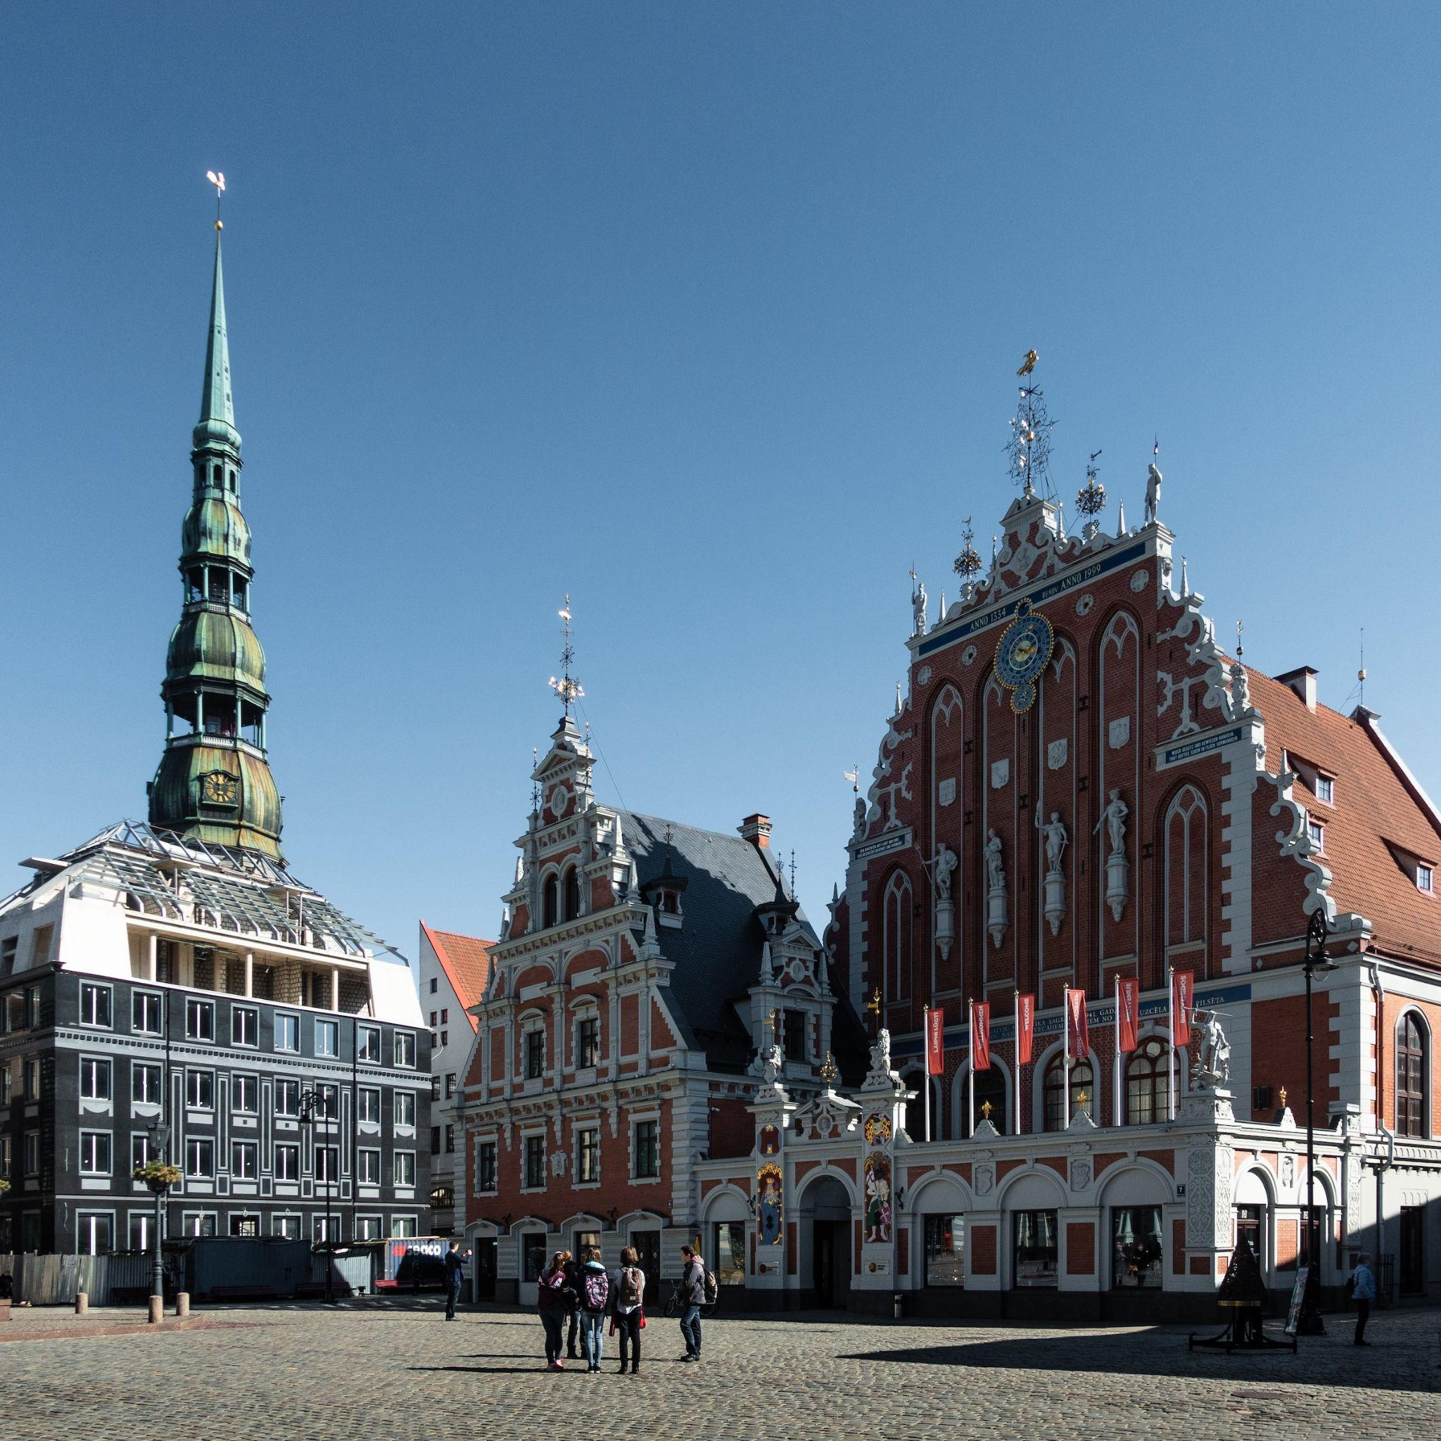
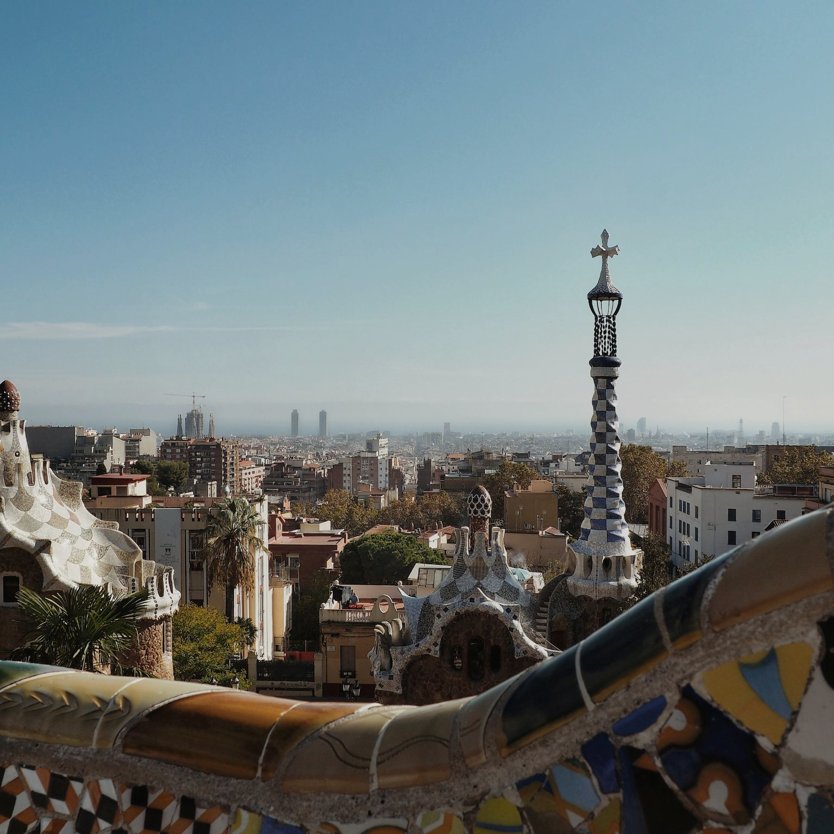
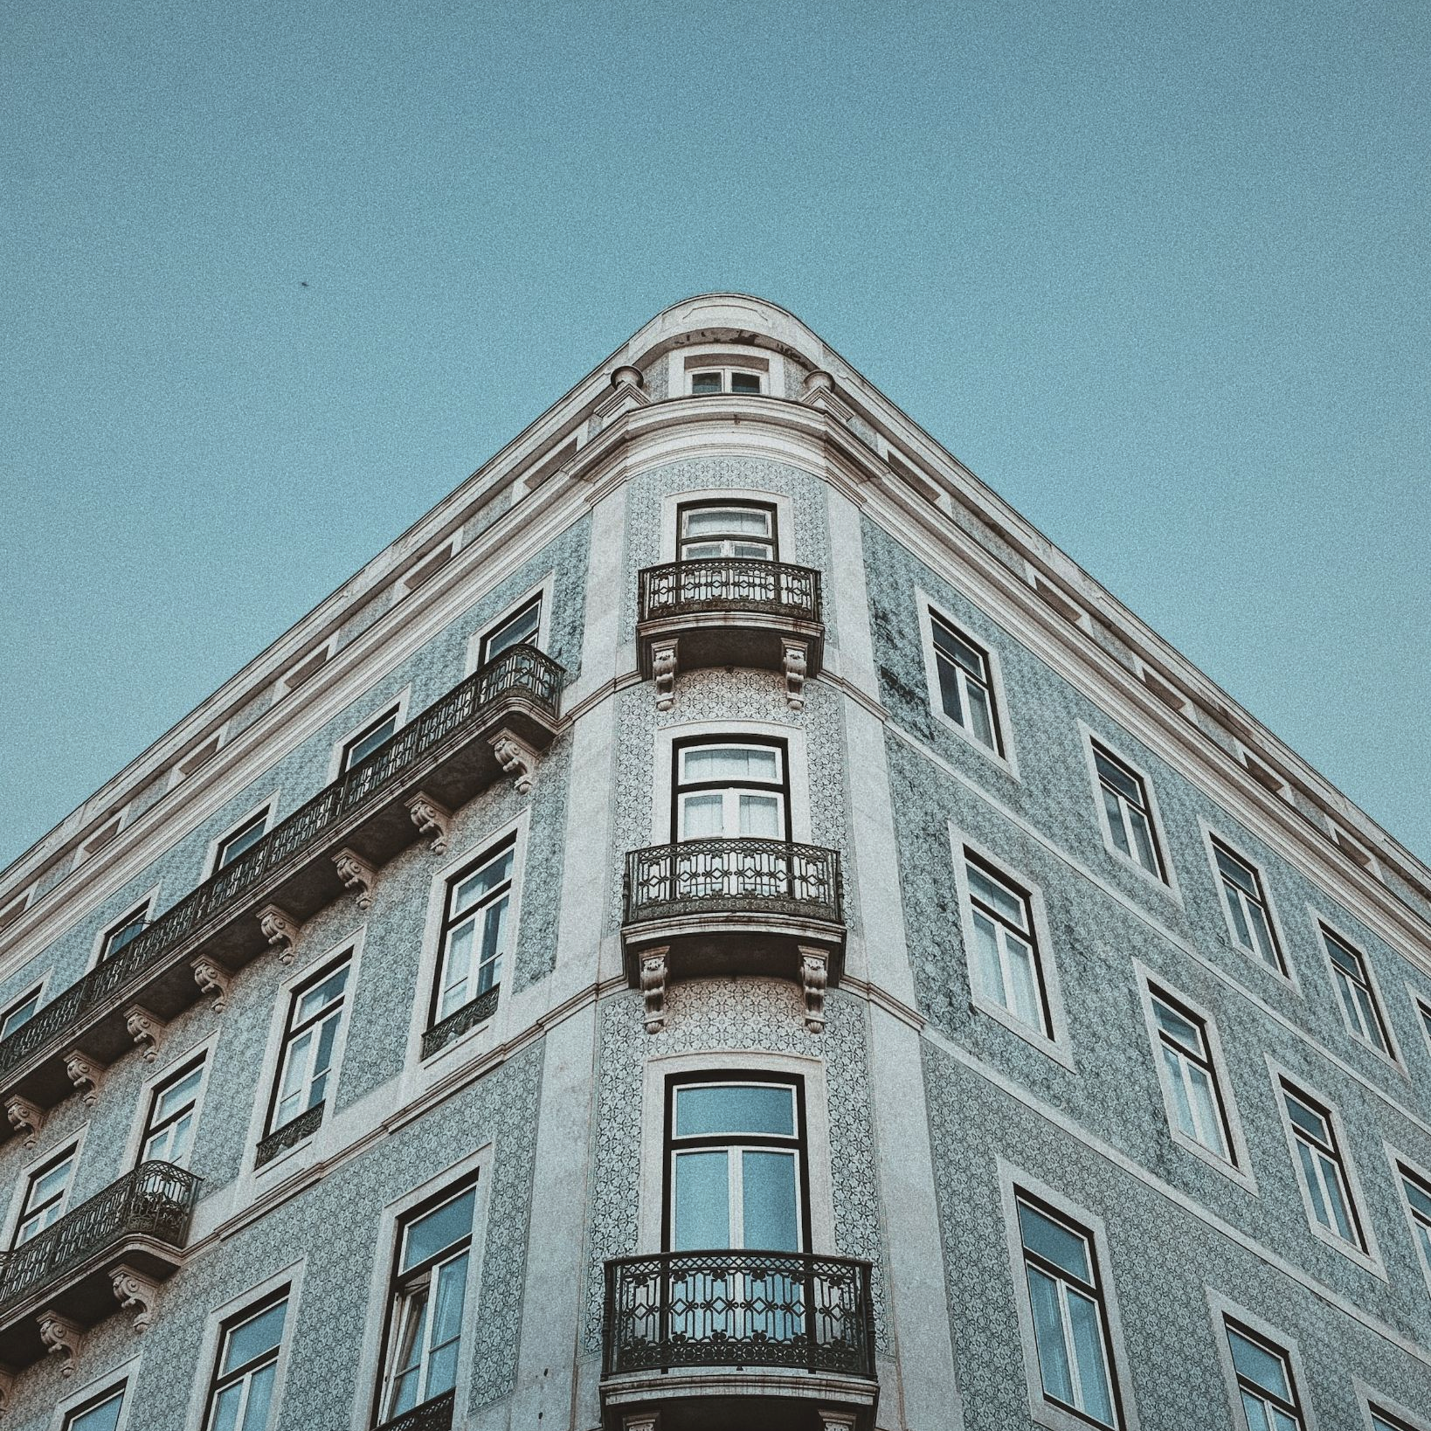
Key Data Insights
RIGA
BARCELONA
LISBON
Apartments | No. of available apartments | 2.801 | 17.230 | 21.337
 | Final dataset: No. of apartments with <= 2 beds after adjusting fake listing & empty Reviews | 904 (38%) | 5.711(33%) | 6.690 (31%)
Price | Avg. price / night | $53,80 | $88 | $88,24
 | Price Range (min - max) | $10 - $1.000 | $8 - $1485 | $10 - $1.000
Rating | Avg. rating in Reviews | 4,77 | 4,59 | 4,61
Coworking Place | No. of Co-Working places | 17 | 111 | 88
 | Avg. Distance to the nearest Co-working place (meters) | 760 | 438 | 717
Host | Host experience (years) | 5.7 | 6.2 | 6.4
 | Hosts with ‘Superhost’ status (%) | 40 | 10 | 16
Amenities | Dedicated Work-Spaces (%) | 52 | 40 | 37
 | WiFi Availability (%) | 89 | 98 | 100

Slide 5
Scoring Criteria
RIGA
BARCELONA
LISBON
Avg. price / night ($) | $51 | $88 | $88
Avg. Rating in Reviews | 4.77 | 4.59 | 4.16
Avg. distance to Co-Working place (meters) | 760 | 438 | 717
Host experience (years) | 5.7 | 6.2 | 6.4
Total attractive score | 2.48 | 2.49 | 2.51

Slide 6
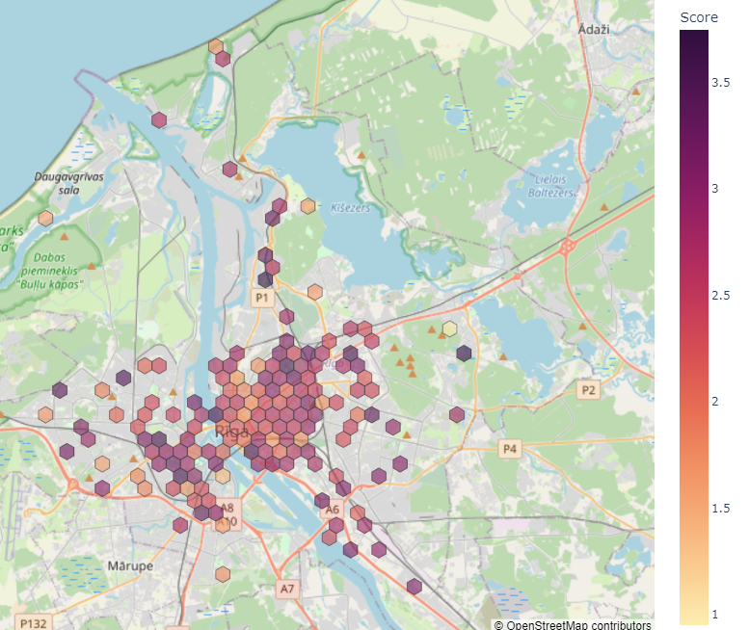
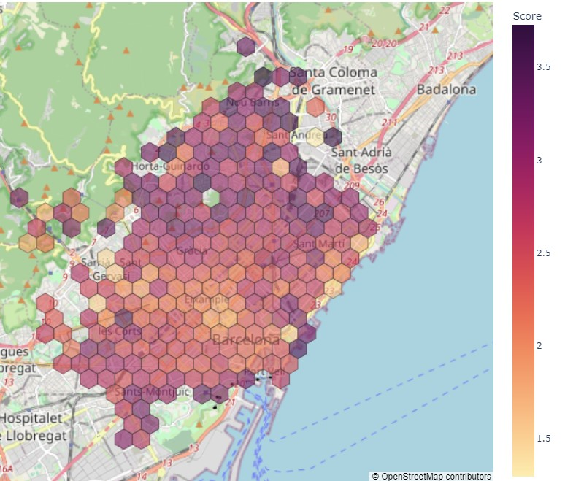
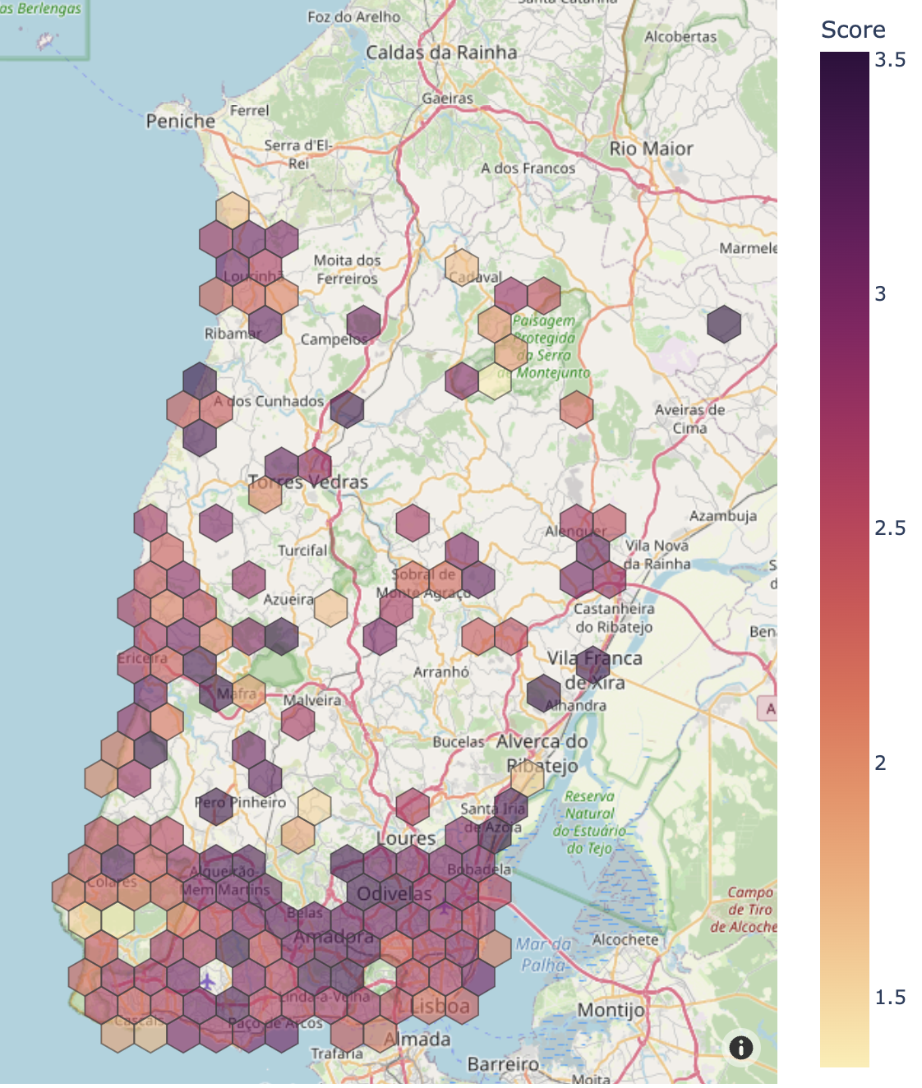
Results & Conclusion
RIGA
BARCELONA
LISBON

Slide 7
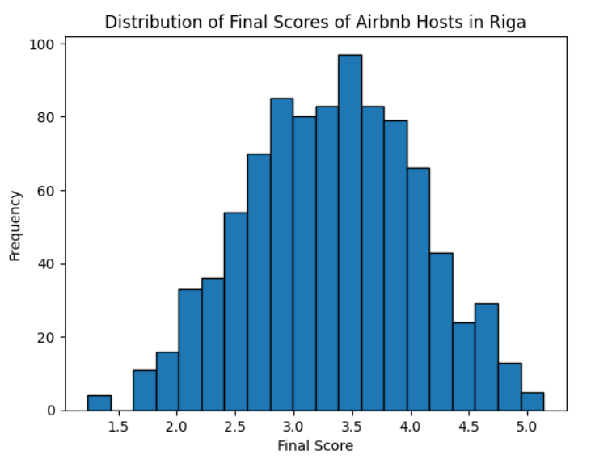
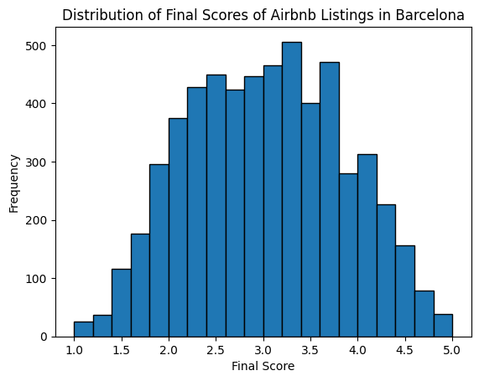
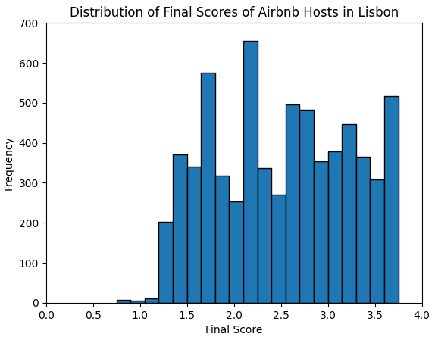
Results & Conclusion
RIGA
BARCELONA
LISBON

Slide 8
Thank you!
Carsten, Swetha, Laurie, Christine, Femke, Christina
Group mentor: Ken Knuetel
Credits: Photo of Riga: Martina Kleppe via Unsplash
Photo of Lisbon: Isabella Abreu via Unsplash
Photo of Barcelona: Alessio Rinella via Unsplash

Slide 9
Thank you!
Carsten, Swetha, Laurie, Christine, Femke, Christina
Group mentor: Ken Knuetel

